Slide 1
Workplace Harassment the other side
Presenters:
Men Welfare Trust & Save Family Foundation (part of Save Indian Family Movement)
Date: 20/Jan/2019

Slide 2
Our Values
Men’s rights
Quasi legal
acumen
brotherhood

Slide 3
History VISHAKA GUIDELINES
13th August 1997, Hon’ble Supreme Court (3 judges bench), ordered guidelines in “Vishaka & Others vs State of Rajasthan & Others”, commonly called as “Vishaka Guidelines”.
The Guidelines were Gender based and applicable only for women.
Guidelines included:
Formation of Complaints Committee
Defined Sexual Harassment
Defined Complaint Committee constitution

Slide 4
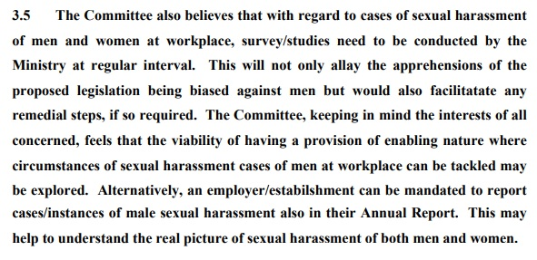
History Workplace Harassment law in making
During the discussions with Standing Committee in 2010, while the Bill was drafted by the Ministry of Women and Child Development, Save Indian Family (represented by many NGOs), presented strong objection to the Bill being Gender Biased. Snippets from Standing Committee report:
“The Committee held meetings with several stakeholders like Saheli, National Domestic Workers Movement, Lawyers Collective, Human Rights Law Network, Centre of Indian Trade Union, All India Women's Conference, SEWA, YWCA, PRIA, National Coalition for Men, Indian Social Awareness and Activism Forum, All India Men's Welfare Association, SCOPE, Office of Chief Labour Commissioner, Indian Banks Association, NASSCOM and CII. The Committee has also been greatly benefitted by the written memoranda received from individuals and organizations like PRS Legislative Research, Rakshk Foundation, Domestic Workers Forum, Gender Human Rights Society, Mother and Sister Initiative, Family India Life Line, Industrial Management Academy etc. ”
“Following were the major concerns expressed on the gender-specific nature of the Bill:-
- It is incorrect to presume that only women can be victims of sexual harassment. Percentage of women workforce is gradually increasing and not all are at subordinate levels.
- Gender should not get any more precedence over human rights.
- Employers are under a duty to provide a safe working environment to all employees.
- The Ministry has no data to claim that sexual harassment is faced only by women and that harassment of men cannot be put on the same footing character-wise or incidence-wise.
- Sexual harassment laws in most countries like Denmark, UK, Italy, Ireland, Finland, France, Germany, Portugal, Spain, Netherlands etc. are gender-neutral.
3.3 On this issue being taken up with the Ministry, it was admitted that data on sexual harassment at the workplace in India was not available. ”

Slide 5
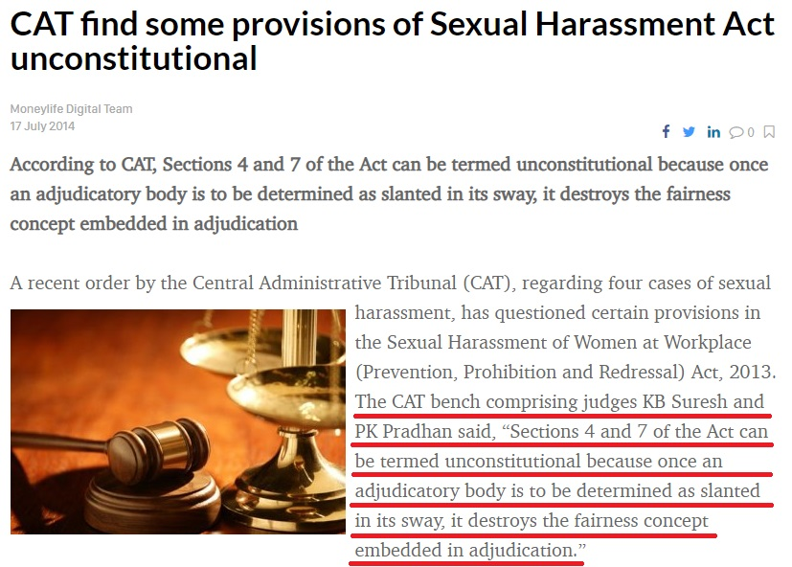
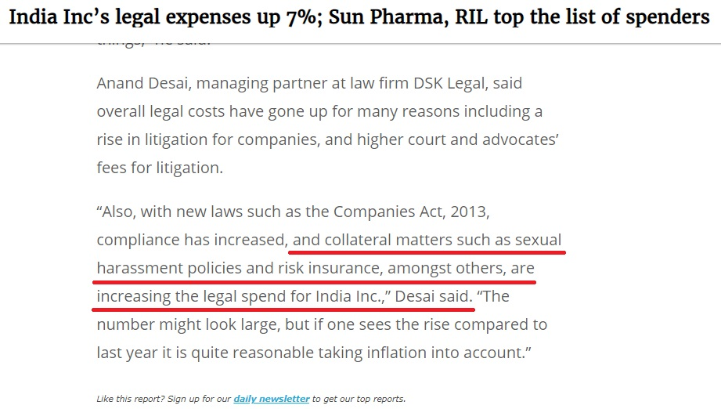
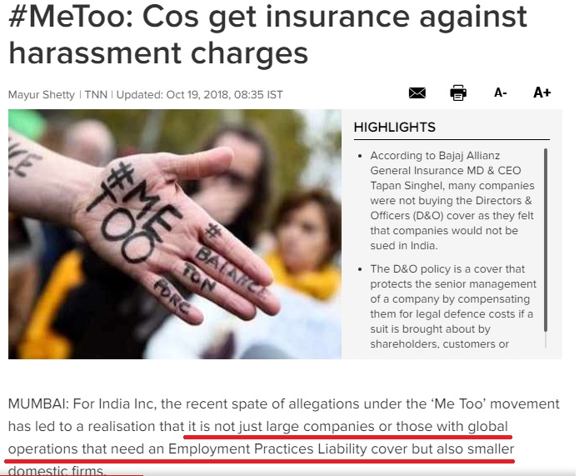
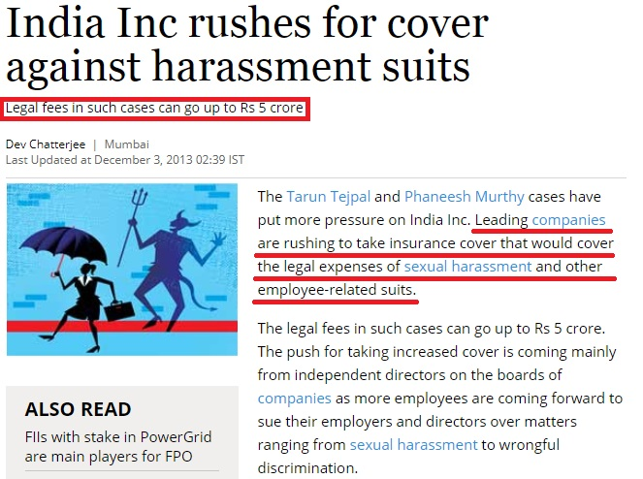
Effects of the new LAW
19th Oct 2018
3rd Dec 2013
19th Sept 2016
17th July 2014

Slide 6
What all is Sexual Harassment, as per Law
Physical Contact or Advances
Demand/Request of Sexual Favors
Making Sexually Colored Remarks
Showing Pornography
Any other unwelcome physical, verbal or non-verbal conduct of sexual nature

Slide 7
What all is Workplace, as per Law
any department, organisation, undertaking, establishment, enterprise, institution, office, branch or unit which is established, owned, controlled or wholly or substantially financed by funds provided directly or indirectly by the appropriate Government or the local authority or a Government company or a corporation or a co-operative society
any private sector organisation or a private venture, undertaking, enterprise, institution, establishment, society, trust, non-governmental organisation, unit or service provider carrying on commercial, professional, vocational, educational, entertainmental, industrial, health services or financial activities including production, supply, sale, distribution or service
Hospitals or nursing homes
any sports institute, stadium, sports complex or competition or games venue, whether residential or not used for training, sports or other activities relating thereto
any place visited by the employee arising out of or during the course of employment including transportation provided by the employer for undertaking such journey
a dwelling place or a house

Slide 8
Other Important Definitions
Aggrieved Women:
any age whether employed or not, who alleges to have been subjected to sexual harassment by the respondent
in relation to a house, any age who is employed in such a dwelling place or house
Employer:
Head of that Department of that Organization
Any person responsible for the Management, supervision, control of that place
Person discharging contractual obligations
A person who employs or benefits from the employment of domestic worker
Circumstances of Sexual Harassment:
Implied or explicit preferential treatment e.g. “My manager said that I can be preferred for promotion, if -------”
Implied or explicit detrimental treatment e.g. “My manager told me that everyone else on team says yes, so you ------”
Implied or explicit threat on current or future employment status e.g. “My manager said, if I want to save my job, then ----”
Interfering in her work / creating an intimidating or offensive or hostile work environment e.g. “Since, I have said “no”, my manager blasts me in front of whole team.”
Humiliating treatment to effect her health of safety e.g. “Even though my right hand has a known hitch, I am forced to do by boss, since I said, “No””

Slide 9
Committees
INTERNAL COMPLAINTS COMMITTEE (ICC)
In case of Employer with more than 10 Employees or when complaint is not against the Employer.
Presiding Officer – Senior Woman Employee
+ Not less than 2 Employees, committed to cause of women / legal knowledge / social cause
+ 1 member from Women NGOs
Atleast 50% members of ICC must be women
Members be paid fees and allowance by Company
In case of Branch offices, ICC must be constituted in all administrative offices/units.
LOCAL COMPLAINTS COMMITTEE (LCC)
In case of Employer with less than 10 Employees or when complaint is against the Employer.
Chairperson – Women Social Worker
+ 1 Working women in Area
+ 2 member from Women NGOs
Atleast 1 member must know law, 1 from SC/ST
Ex-officio WCD member
Members be paid fees and allowance by Government
To be audited by Accountant General.

Slide 10
Process
Can she write?
Delay more than 3 months?
ICC / LCC ok with delay?
Complaint
Yes
ICC / LCC
Yes
No
No
ICC/LCC to write
No
Yes
Close the case
Accepted Complaint
Forward to file IPC 509 / other FIR
No
Yes
Yes
Is Complaint False?
Completed. Guilty?
Prima Facie Case?
No Money Settlement?
No
Within
90 Days
Continue Inquiry
Yes
Within 7 days
As per service rules
Inquiry
No
Yes
Yes
No
Yes
Punishment as per Service Rules
Respondent not abiding to terms?
Close & give copies

Slide 11
What else to know?
Court, in case of conviction, can order Monetary punishment over and above IPC punishment
IPC 509 is Bailable, Cognizable, Compoundable with 3 years SI + Fine
ICC / LCC have powers of Civil Court w.r.t. Summoning, examining on oath, documents production etc.
During Inquiry, on written request from complainant, she/accused can be transferred, she can be granted leaves upto 3 months (above entitlement)
ICC / LCC to provide report of findings to Employer, both parties within 10 days
In case of found guilty by ICC / LCC, Employer can recover fine from salary of defaulter
Mere inability to substantiate or unable to give adequate proof doesn’t mean false case
Identity of all parties, witnesses, findings, employer action can not be published (nor RTI)
In case of information leak to public, person entrusted with information, is liable for fine as per rules
Appeal against or for ICC / LCC findings can be made in court/tribunal within 90 days
ICC / LCC to submit annual report to Employer, District officer
Not following this law may result in upto INR 50,000 penalty for Company

Slide 12
What to do, when facing ICC/LCC
Please ask for the complaint copy, it is your right
Immediately, take control of all the evidences of your defense
Everything can be evidence: Emails (with headers), SMS, Whatsapp, Social Media, Chats, Intranets, Colleagues, CCTVs etc. etc. Don’t ignore any evidence
Present your side with confidence. There is hope of justice. Fight for it
Do not let your performance be effected in any circumstance
Don’t succumb to resignation push. Try to convince, reason out and push to follow the process
Colleagues and office friends as witness help a lot. So make friends, not enemies at workplace
Be very sharp. Focus on every detail of every allegation and think which evidence can fit to falsify it
Target is just not to prove allegation false, Target can also be to prove the improbability of the allegations
It is good to have a god-father

Slide 13
What to do, when facing Police
IPC 509 is Bailable and most of the sections of IPC 354 are also bailable so don’t worry
Police has the responsibility to investigate, and like the society, they are also under pressure to be the protector of the other gender
Participate in Investigations
Student who has 100% attendance gets grace marks. Possibility exists here too
Police is also a government authority. Written words work more than spoken
RTI works now
Establish to motive behind a false complaint
Having a negative ICC / LCC report is not binding on Police. Police does its own investigation. Final IPC conviction is only in the hands of the Courts.
Police, if things are done right, can also be pushed to use IPC 182
Police can also be requested to ask for specific evidences, that you may need from employer, via CrPC 91 requests
Police has to finally file it’s investigation report in the court (called as Chargesheet / Final Report)

Slide 14
What to do, when in Court
All the IPC sections, pertaining to this Act, follow Criminal Procedure Code
Offences under this Act are tried at Criminal Court (or Trial Court)
In case a non-bailable section is there in your Police FIR, better to take Anticipatory Bail from Sessions Court (or Stay on Arrest from HC, in UP/UK)
Once Chargesheet is filed by Police, process is: Charge Framing, Prosecution Witness & Evidence, Prosecution Witness cross examination, Defense Witness & Evidence, Defense Witness Cross Examination, Arguments, Judgment
Evidences, filed in court, need to comply to Indian Evidence Act, Electronic Evidences act etc.
Having a Court case doesn’t mean you are convicted
Having negative ICC / LCC report, negative Police Chargesheet doesn’t mean conviction is by default. You will have your chance to defend as bias in any other body can not be ruled out
Take interest in your case

Slide 15
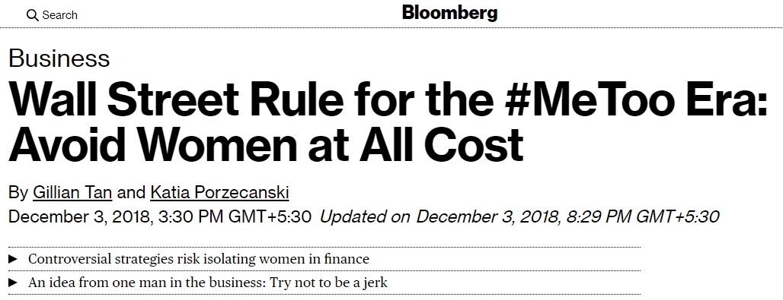
What’s happening now
No more dinners with female colleagues. Don’t sit next to them on flights. Book hotel rooms on different floors. Avoid one-on-one meetings.
In fact, as a wealth adviser put it, just hiring a woman these days is “an unknown risk.” What if she took something he said the wrong way?
Across Wall Street, men are adopting controversial strategies for the #MeToo era and, in the process, making life even harder for women.
Call it the Pence Effect, after U.S. Vice President Mike Pence, who has said he avoids dining alone with any woman other than his wife. In finance, the overarching impact can be, in essence, gender segregation.
Interviews with more than 30 senior executives suggest many are spooked by #MeToo and struggling to cope. “It’s creating a sense of walking on eggshells,” said David Bahnsen, a former managing director at Morgan Stanley who’s now an independent adviser overseeing more than $1.5 billion.
This is hardly a single-industry phenomenon, as men across the country check their behavior at work, to protect themselves in the face of what they consider unreasonable political correctness -- or to simply do the right thing. The upshot is forceful on Wall Street, where women are scarce in the upper ranks. The industry has also long nurtured a culture that keeps harassment complaints out of the courts and public eye, and has so far avoided a mega-scandal like the one that has engulfed Harvey Weinstein.
https://www.bloomberg.com/news/articles/2018-12-03/a-wall-street-rule-for-the-metoo-era-avoid-women-at-all-cost

Slide 16
Prevention (just Don’t’s)
Get CCTV installed. Try to get as much captured, as possible
While taking one on one interaction with female colleague, do in CCTV or call 3rd person
Avoid Chivalry. Dropping home may result in Invitation of False POSH case
Stay away from Habitual litigators
All Male victims MUST report to the ICC, LCC about harassment
Ask your Company to form gender neutral policy
You are not the only one and you are not the only one with false accusation
Try to be part of ICC/LCC, as it allows

Slide 17
Some known reasons of Misuse
Forcing Promotions
Bad performance
Job Interview
Forced Sales
Stopping Transfers
Ex-Employees
Paid 3 months leave
Failed Relationships
Company hostility
Extortion
Covering Corporate misappropriation
Office Relationship Break-Ups
Consensual Relationship going sour / public
Personal Vendetta / Motives
Professional Rivalry

Slide 18
What can we do?
Write to Standing Committee asking on Sexual Harassment of Men report, surveys
Write to Finance Minister, Commerce Minister, CII, FICCI about reality of Sexual Harassment
Ask your ICC / LCC (in writing) about submissions of Annual Reports and Male Harassment
Don’t wait to be an accused. Everyone is the flag bearer to bring the change
Crime has no Gender, but Law has. We have to work to correct later
Don’t punish yourself by outcasting yourself. Be Social and live your life
Try to get this training to as many corporate as possible
Don’t treat your company, police, courts, as enemies
Don’t think that only your case if false. Have compassion for others

Slide 19
ET Synovate SH Survey 2010 snapshots
Of all perpetrators of SH: 33% Male Colleagues, 32% Female Colleagues, 20% Male Bosses, 12% Female Bosses, 3% others. So, over 44% were females.
Of all perpetrators of SH, in Bangalore: over 53% were females.
Of all perpetrators of SH, in Delhi: over 47% were females.
Over 38% said men are vulnerable to SH.
Women are bigger SH offender in Bangalore.
Bangalore is Workplace Sexual Harassment Capital of India.
Men and Women, both are victims of SH.
Reference Article: https://economictimes.indiatimes.com/special-report/even-men-arent-safe-from-sexual-harassment-at-workplace-survey/articleshow/6389438.cms

Slide 20
Thank You
menwelfaretrust@gmail.com contactsavefamily@gmail.com sifhelpline@gmail.com
SIF ONE – HELPLINE FOR MEN 8882 498 498

